Slide 1
climate change and global warming
The QUIZ

Slide 2
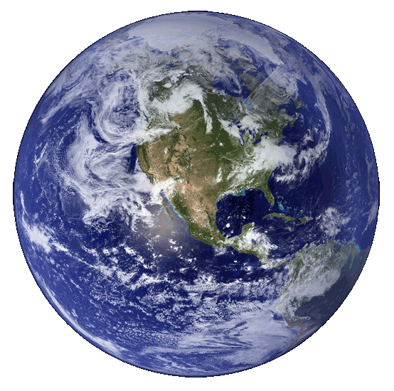
What is the term describing changes in climate occurring from the Earth’s formation until today?
A.) Climate change
B.) Atmospheric changes
C.) Ozone hole
D.) Everyday changes

Slide 3
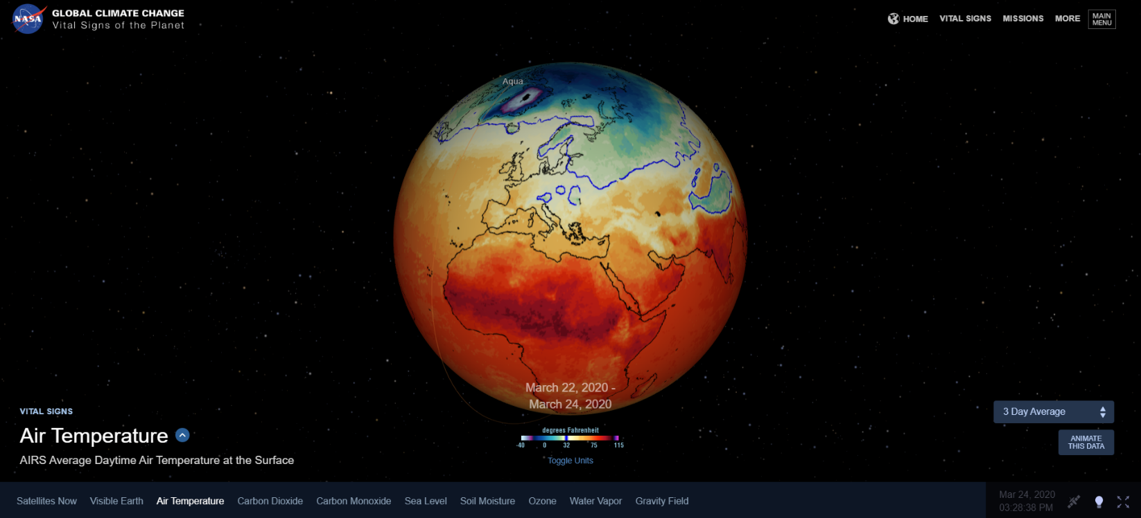
Source: https://climate.nasa.gov/earth-now/

Slide 4
In the ice age the temperature on Earth changed due to:
A.) Sun’s weak radiation
B.) Movement of lithospheric plates
C.) The Earth was spinning slower
D.) There is no known cause

Slide 5
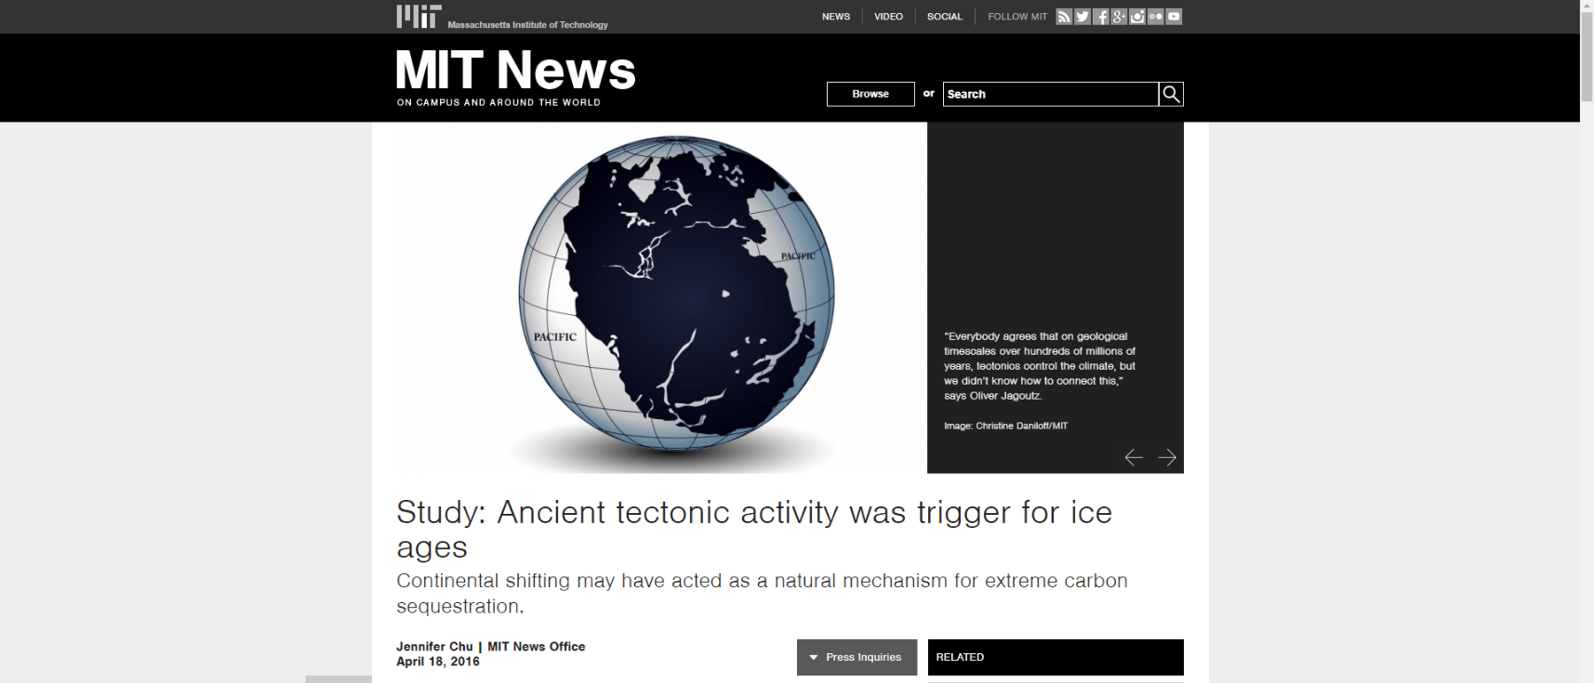
Source: http://news.mit.edu/2016/ancient-tectonic-activity-was-trigger-for-ice-ages-0418

Slide 6
How do we call the increase of the average temperature on Earth?
A.) The rise of air temperature
B.) Warm period
C.) Global warming
D.) Ice age

Slide 7
Global warming is the long-term rise in the average temperature of the Earth's climate system

Slide 8
Greenhouse is a place to grow vegetables, “greenhouse effect” is then:
A.) Heating of the air due to greenhouse gases
B.) Heating of the air due to dessert enlargement
C.) Tropical rainforest deforestation
D.) Heating of the oceans

Slide 9
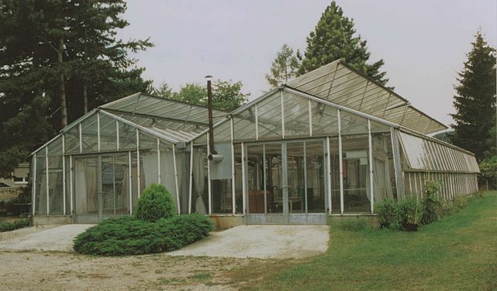
Greenhouse effect

Slide 10
Greenhouse effect is important for maintaining suitable surface temperature for living otherwise the average temperature on Earth would be:
A.) Colder
B.) Hotter
C.) Same as now
D.) With no effect

Slide 11
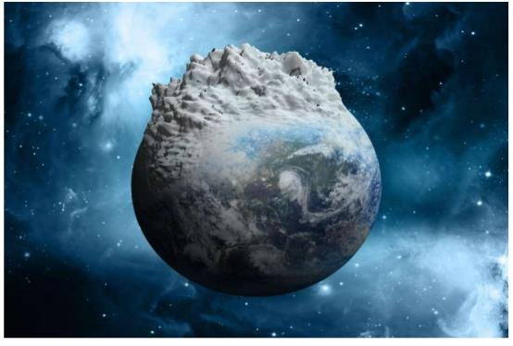
Without the greenhouse effect, the Earth´s average surface
temperature would be …me 3 colder ....
Source: www.slideshare.net

Slide 12
Majority of greenhouse gases, such as carbon dioxide (CO₂), methane (CH₄), nitrogen (NOx) and sulphur oxides (SO_{x}), is released:
A.) When glaciers are melting
B.) When using wind turbines
C.) When using electricity
D.) When using fossil fuels

Slide 13
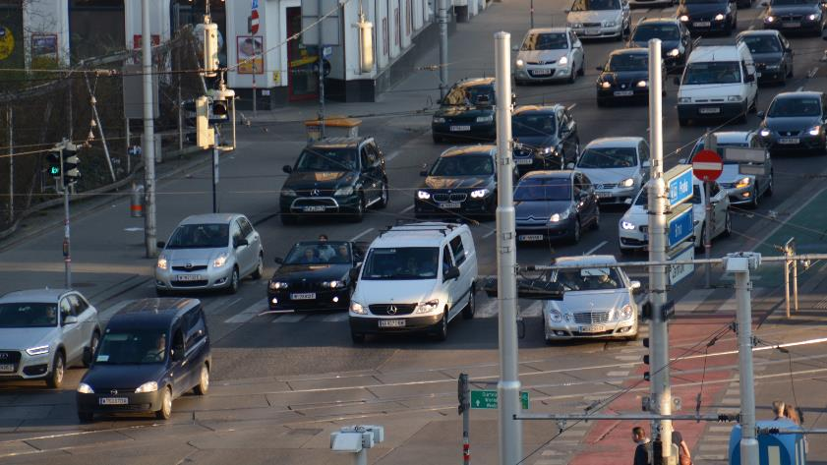
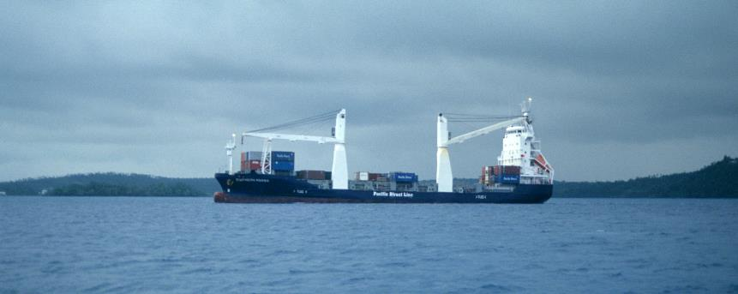
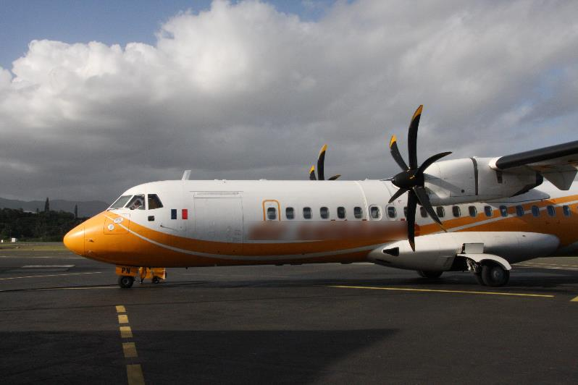

Slide 14
Who uses the most of carbon dioxide?
A.) Plants and oceans (algae and phytoplankton)
B.) Humans and animals
C.) Industry
D.) No one

Slide 15
CO₂
O₂

Slide 16
The needs for energy consumption are globally still rising but the fossil fuels are slowly disappearing. These can be substituted with:
A.) Renewable energy sources (sun, wind, water)
B.) Waist
C.) We cannot replace these
D.) Nuclear energy

Slide 17
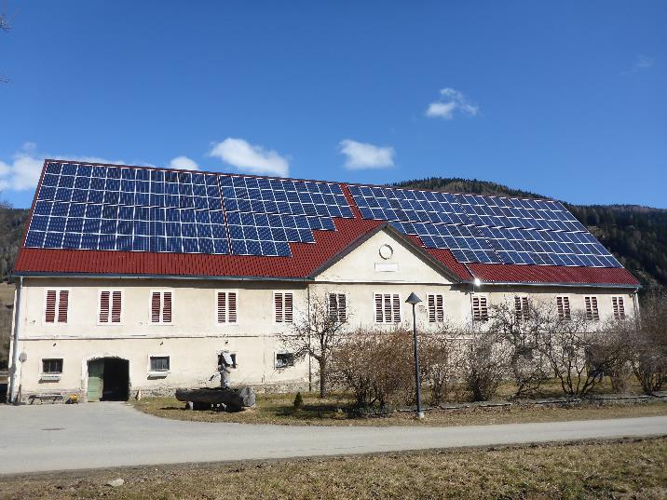
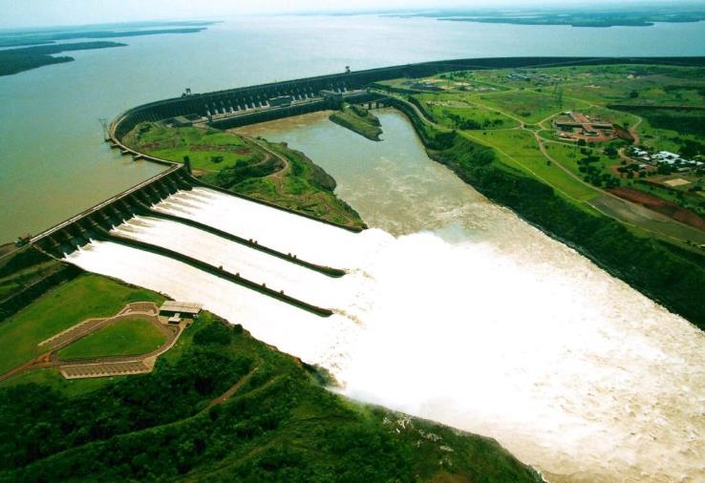

Slide 18
What is the name of the international agreement encouraging the reduction of greenhouse gas concentrations to be released in the atmosphere signed by several countries worldwide in 2005?
A.) Europe protocol
B.) Worldwide protocol
C.) Kyoto protocol
D.) NATO protocol

Slide 19
Kyoto Protocol (1997)
Source: www.slideshare.net

Slide 20
How can each one of us contribute to the reduction of greenhouse gases?
A.) Driving a bicycle and use of solar energy
B.) Driving with a car as fast as possible, to reach final destination quicker
C.) Heating using oil
D.) Traveling by plane

Slide 21
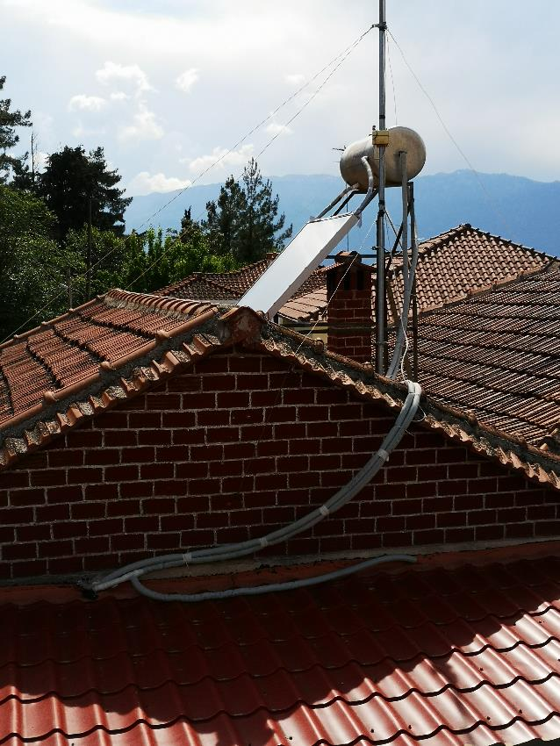
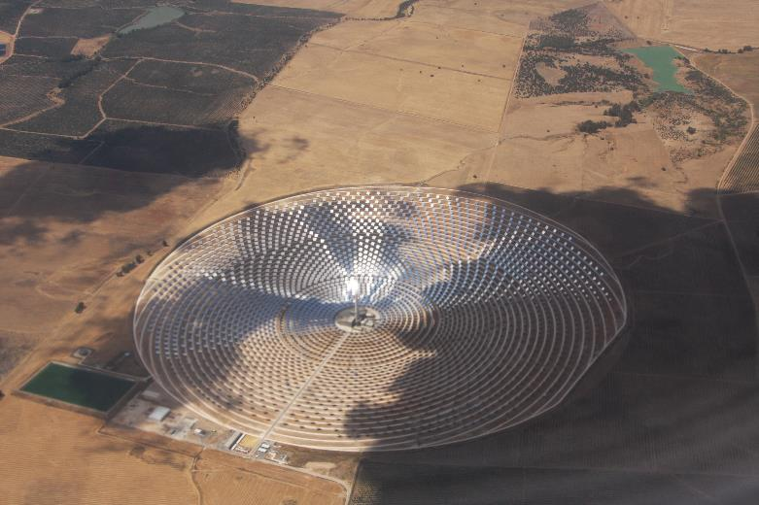

Slide 22
What does the term carbon footprint mean?
A.) Drawing using coal
B.) Calculation of how much CO₂ is released into the atmosphere with certain activity
C.) Printing using carbon
D.) It has no meaning

Slide 23
Carbon footprint
You can calculate your carbon footprint on:
https://www.carbonfootprint.com/calculator.aspx
Source: www.ecosoch.com

Slide 24
Why is it getting warmer on Earth?
A.) Less greenhouse gases in the atmosphere
B.) More rain
C.) Less rain
D.) More greenhouse gases

Slide 25
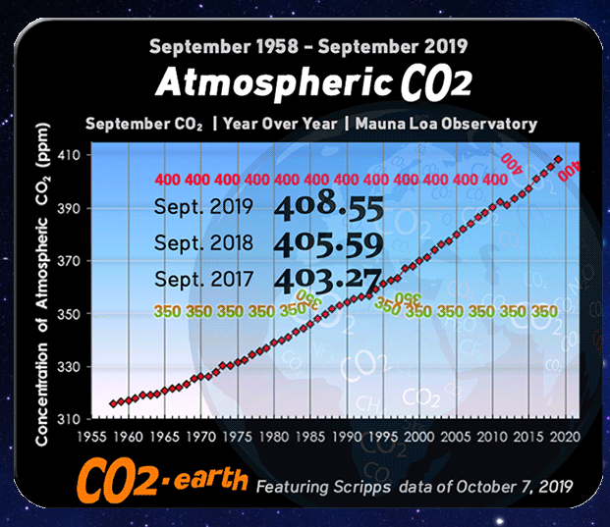
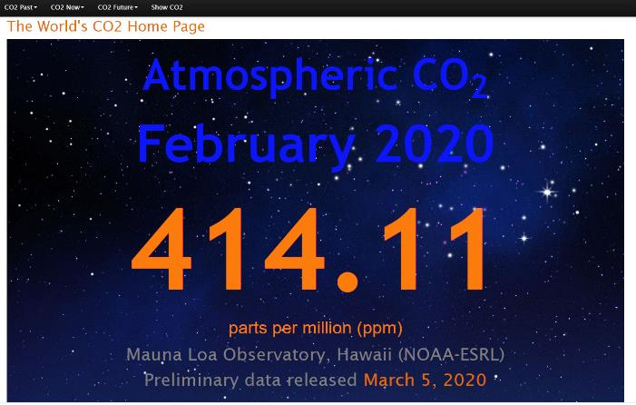
Source: https://www.co2.earth/

Slide 26
What would be the average temperature on Earth without greenhouse effect?
A.) - 50° C
B.) + 15 °C
C.) – 18 °C
D.) + 30

Slide 27
Without the greenhouse effect, the Earth´s average surface
temperature would be some 30°C colder or approximately – 15°C
and possibly not warm enough to sustain life.
Source: www.slideshare.net

Slide 28
Well Done!

